Slide 1

Past Simple
&
Past Continuous

Slide 2
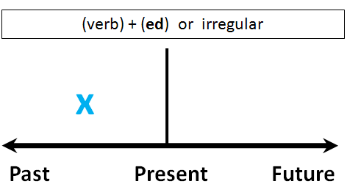
Past Simple
Use:
Past actions that are now finished
(often with time expression)
Examples:
I went to China a year ago.
My parents married in 2003.
She gave him a present on his birthday.

Slide 3

Past Simple +
Form:
Regular verbs: verb + ed
Examples:
love – loved
work – worked
stop – stopped
study – studied
play – played
Irregular verbs, second row

Slide 4

Past Simple -
Negative
didn’t + infinitive
Examples:
I walked home. I didn’t walk home.
She gave him a kiss. She didn’t give him a kiss.
We saw a film. We didn’t see a film.
He worked hard. He didn’t work hard.

Slide 5

Past Simple ?
Questions:
did + infinitive
Examples:
I walked home. Did you walk home?
She gave him a kiss. Did she give him a kiss?
We saw a film. Did we see a film?
He worked hard. Did he work hard?

Slide 6
Past Simple practise
Extra practise:
http://www.ego4u.com/en/cram-up/grammar/simple-past/exercises?04
http://www.ego4u.com/en/cram-up/grammar/simple-past/exercises?06
http://www.ego4u.com/en/cram-up/grammar/simple-past/exercises
http://www.learnenglish.be/gr2_pasi_ex6.htm
http://www.eslgamesplus.com/irregular-past-simple-spelling-activity-online-for-esl/
Extra explanation:
http://www2.thiememeulenhoff.nl/msite-newinterface/file.asp?fileid=23552

Slide 7
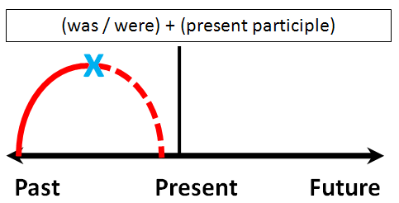
Past Continuous
Use:
Past actions that are now finished
and have duration
(often with time expression)
Examples:
It was raining all day.
Yesterday evening, I was watching television.
We were working in the garden.

Slide 8
Past Continuous +
Form:
was/were + verb-ing
Examples:
I was working.
You were digging.
He was going.
We were arriving.
They were trying.

Slide 9
Past Continuous -
Negatives:
wasn’t / weren’t + verb-ing
Examples:
I wasn’t working very hard.
You weren’t thinking.
They weren’t trying.
She wasn’t swimming.

Slide 10
Past Continuous ?
Questions:
was/were + subject + verb-ing
Examples:
Were you working hard?
Was he thinking?
Were they swimming?
Was I trying?

Slide 11
Past Simple practise
Extra practise:
http://www.perfect-english-grammar.com/past-continuous-exercise-1.html
http://autoenglish.org/gr.pascon.i.htm
http://www.ego4u.com/en/cram-up/tests/past-progressive-3
http://eslkidsworld.com/Interactive%20games/Grammar%20Games/Past%20Continuous/past%20continuous%20quiz.html
Extra explanation:
http://www2.thiememeulenhoff.nl/msite-newinterface/file.asp?fileid=23553
Past Simple vs Past Continuous:
http://www2.thiememeulenhoff.nl/msite-newinterface/file.asp?fileid=23554
http://www.eslgamesworld.com/members/games/grammar/perfectpast/past%20progressive%20vs.%20past%20simple%20betting.html

Slide 12
What’s the difference?
 | Present | Past
Simple
Continuous
For facts & habits
Every day, every
morning etc.
Inf. / SHIT-rule
For completed actions
Yesterday, in 2010, 2 months ago etc.
+ed / irr. verbs
Happening (around)
now
Now, this afternoon,
this Saturday etc.
‘to be’ + - ing
Past actions with
duration
Longer actions in past
While
Was/were + -ing

Slide 13
Practise!
Present Simple vs Past Simple:
http://www.tolearnenglish.com/exercises/exercise-english-2/exercise-english-87374.php
Present Simple vs Present Continuous
http://www.englishpage.com/verbpage/verbs2.htm
Mixed exercises:
http://www.englishexercises.org/makeagame/viewgame.asp?id=2935

